Slide 1



Leakage current systematic
Jacob Thorne

Slide 2
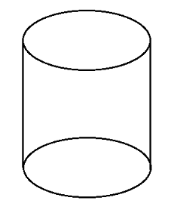
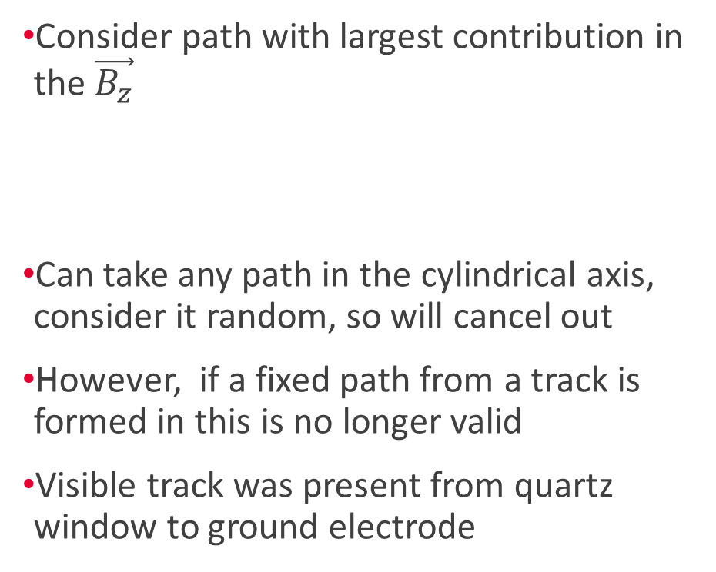
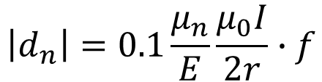
Direction of leakage current
Consider path with largest contribution in the $\vec{B_{z}}$
Can take any path in the cylindrical axis, consider it random, so will cancel out
However, if a fixed path from a track is formed in this is no longer valid
Visible track was present from quartz window to ground electrode
HV
$$\left|d_{n}\right|=0.1\frac{μ_{n}}{E}\frac{μ_{0}I}{2r}∙f$$
Ground

Slide 3
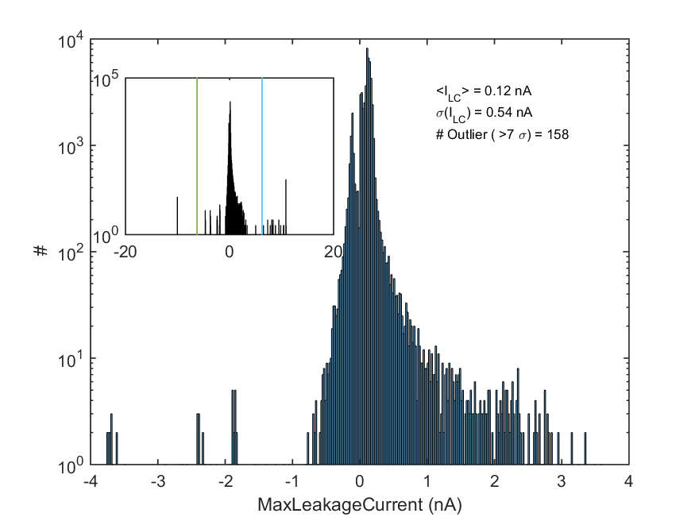


$$d_{n_{−}}\sim 0.1 nA$$
$$d_{n_{+}}\sim 0.5 nA$$

Slide 4

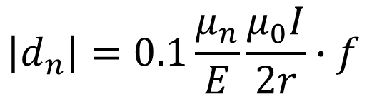
Systematic effect
Using values: E = 11.8 kV/cm, I = 0.5 nA, r = 23.5 cm, f = 0.062
$$\left|d_{n}\right|=0.1\frac{μ_{n}}{E}\frac{μ_{0}I}{2r}∙f$$
$$\left|d_{n}\right| \sim 4×{10}^{−29}e∙cm$$

Slide 5

Worst Case Systematic effect
Using values: E = 11.8 kV/cm, I = 0.5 nA, r = 23.5 cm, f = 1!
$$\left|d_{n}\right|=0.1\frac{μ_{n}}{E}\frac{μ_{0}I}{2r}∙f$$
$$\left|d_{n}\right| \sim 1×{10}^{−27}e∙cm$$

Slide 6
Backup slides

